Slide 1
Evolving systems design from unreliable rpc to resilience with Linkerd
Edward Wilde

Slide 2
Notes:
Hi I’m Ed,
I’m a developer I work at form3
In the last 18 months we’ve built a new SaaS payments platform that allows financial institutions to send payments between bank accounts over faster payments, bacs, sepa and swift.

Slide 3
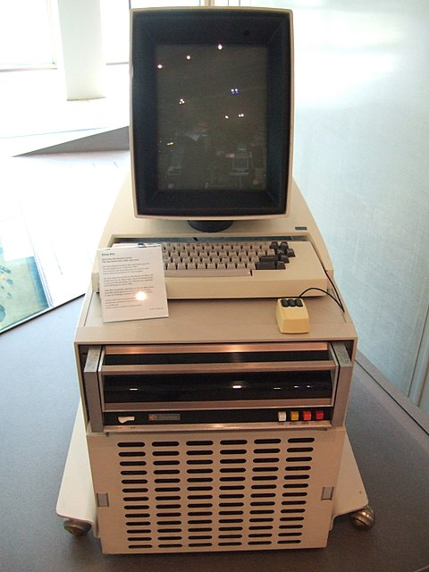


Notes:
I really love stories about software & hardware development:
Some personal favorites:
Dealers of lightening which charts the success of the Xerox parc research laboratory founded in 1970 to explore the office of the future. In 5 years invented:
The laser printer
Object oriented programming with Smalltalk
Bitmap graphics
First GUI based personal computer ($20K)
Ethernet
Show stopper!

Slide 4
A story about unreliable RPC
System 1
Increased reliability
Reduced overall latency
But….
Did not manage to reduce tail-latency
Did not manage to protect services
System 2
Increased reliability
Reduced overall latency
Protected services
But…
Still need to work more on tail-latency
Notes:
My brief story is how the same group of engineers worked on two different systems improving inter-service communication

Slide 5
System 1
Notes:
5 years ago I joined a trading company
The system allow customers to shares, foreign exchange and commodities
The system was api driven and made up of more than 200 services, with many instances of each service, spread across two datacenters in active / active arrangement
The system worked well, however we sometimes got reports from customers that they would place a trade and nothing would happen
In this talk, I’m going to cover how we tried to solve that problem and look at some different types of architectures

Slide 6
Notes:
We will look into why we had those intermitant, problems. But first I would like to define a few terms
Monolith and microservice

Slide 7
System 1
Notes:
The request would be placed on a queue
Service-b would process the request and place the response on the `response queue`
Where it would get picked up by the api gateway and send back to the client
This worked ’okay’ for the majority of cases under normal load
However occasionally we would get reports from customers that they placed a trade and saw nothing happen

Slide 8
Timeout!
Notes:
What was happening is that the request would timeout waiting for a response
We noticed that using a message broker in an RPC call chain didn’t seem to perform well under load, it was also a centralized point of failure

Slide 9
Let’s try http
Notes:
We started with one service and replaced the service-to-service communication with straight forward http proxying
In our lab this performed much better than using the message broker
We were happy and congratulated ourselves on our brilliant idea!

Slide 10
Oops still timeout
Notes:
That was until we started seeing timeouts again

Slide 11
Try that again
Notes:
We noticed that the timeouts some times occurred when a service was garbage collecting, if it had just gone to another instance!
So we wrote a little retry library, in most cases the next request would succeed

Slide 12
Busy day, more timeout
Notes:
When the system was particularly busy we still saw the timeouts, and our retry code was making a bad situation worse!
As all the services were busy, retry was not a particularly sensible option

Slide 13
System 2: Service to service communication in a microservices architecture
Notes:
When we started form3 we decided to use the microservice architecture pattern mainly due to the benefits we mentioned earlier on: easier to scale the software and teams
We were also conscious of the problems we encountered on our last system with service-to-service communication
We looked at using an off-the-shelf libraries that would handle retry, back-off and circuit-breaker
Con
These libraries are language specific
Maintaining these libraries becomes difficult

Slide 14
Service mesh
Retry failures / timeout
Implements circuit breaker
Security
Routing logic & service discovery
Blue / green deployments: canary releases etc…
Distributed Tracing
Other services meshes are available: istio
Notes:
A service mesh is a dedicated piece of infrastructure to manage service to service communication

Slide 15
Tracing

Slide 16
Service mesh in a microservices architecture
Notes:
Here you can see why it’s called a mesh
Between host computers you call via the proxy

Slide 17
Demo: system-1

Slide 18
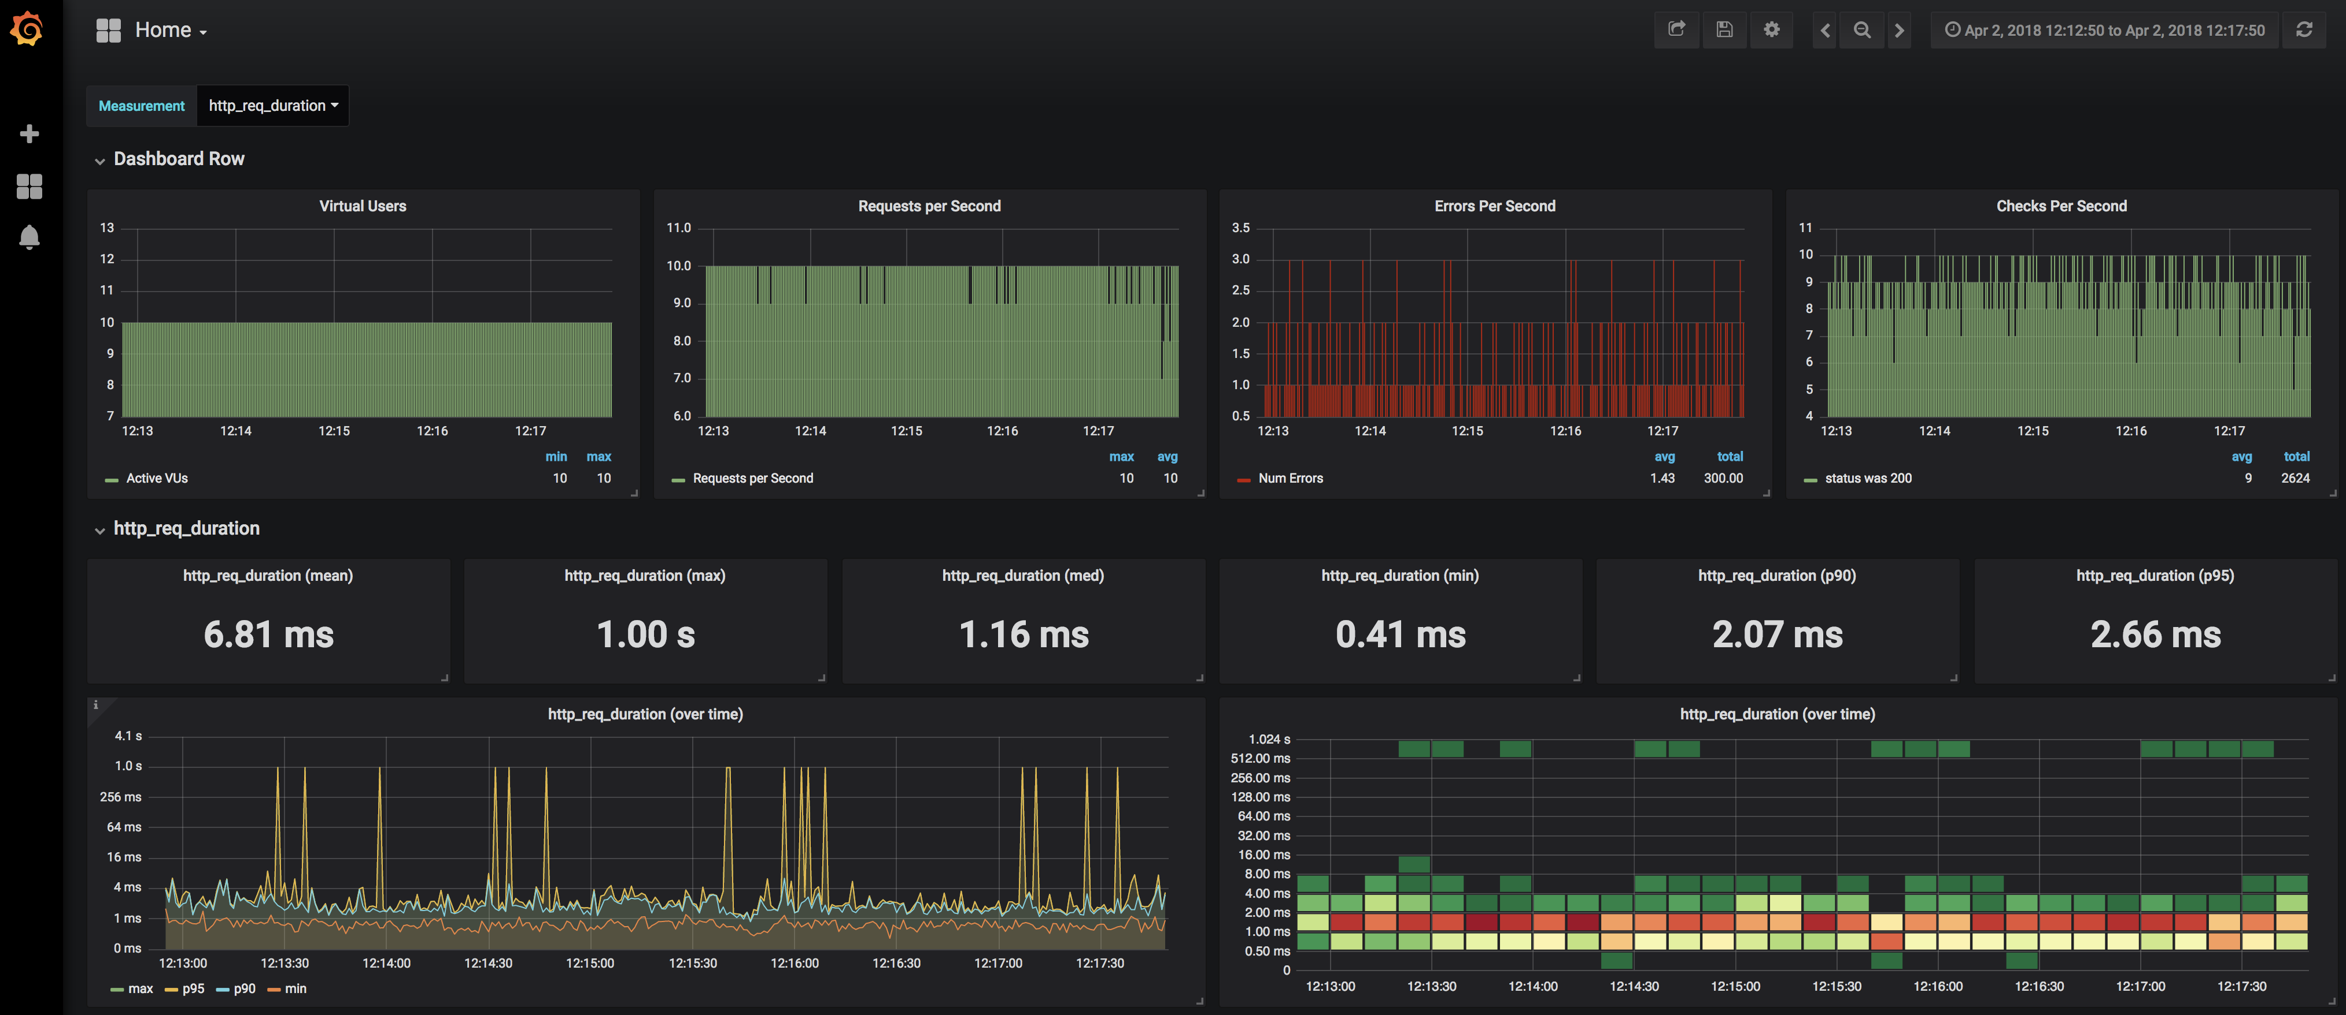
System 1: Response times

Slide 19
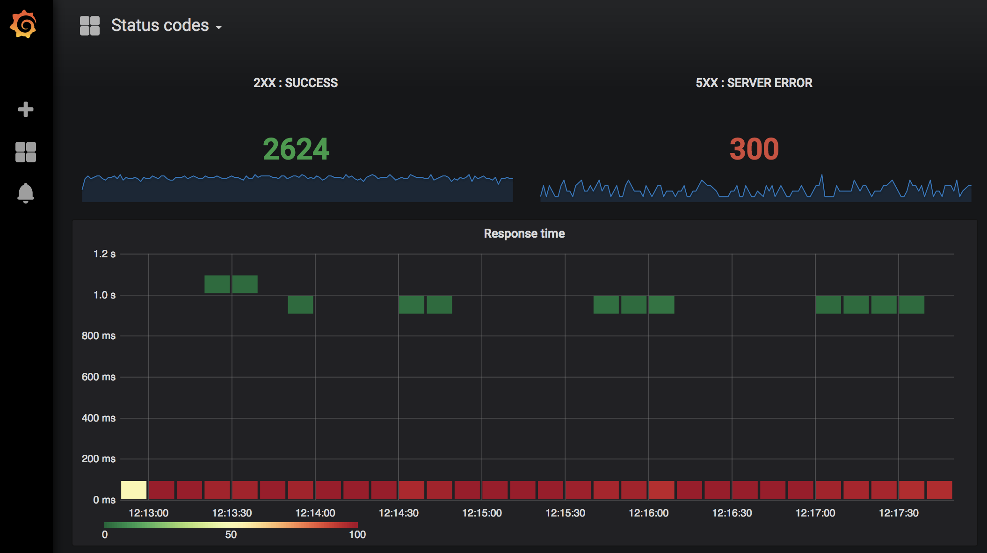
System 1: Response times

Slide 20
Demo: system-2

Slide 21
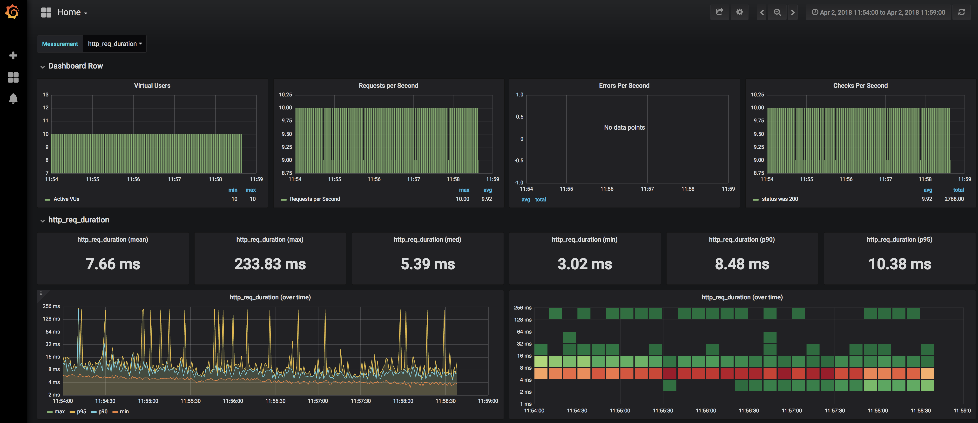
System 2: Response times

Slide 22
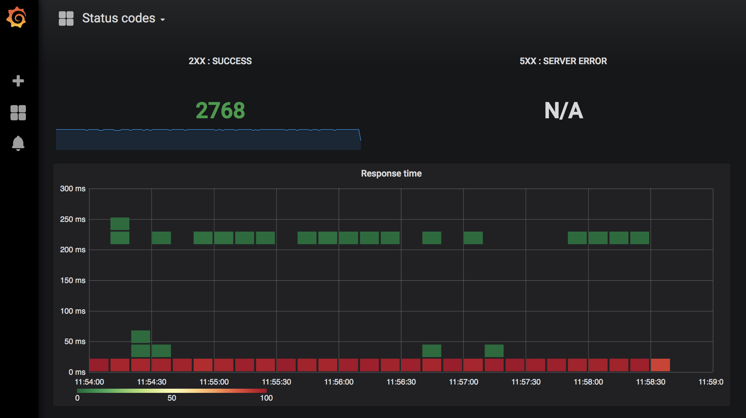
System 2: Response times

Slide 23
Further improving tail latency

Slide 24
Wrap it up
We have used Linkerd to
Reduce error rates using retries
Minimize tail latencies using timeouts
Increase security
Help diagnose problems using tracing

Slide 25

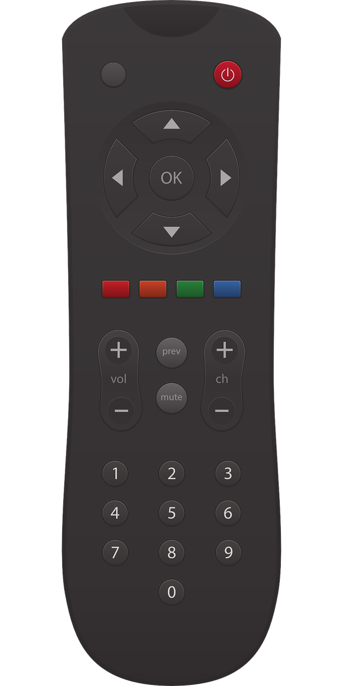

Thank you
service mesh yay!
https://github.com/ewilde/kubecon
this talk
and/or
https://form3.tech
working

